Slide 1
Teaching FLC: Everything You Wanted to Know About Teaching but Were Afraid to Ask!
Facilitators:
Dr. Tom Reichert, Department of Advertising and Public Relations
Dr. Paul Quick, Center for Teaching and Learning

Slide 2
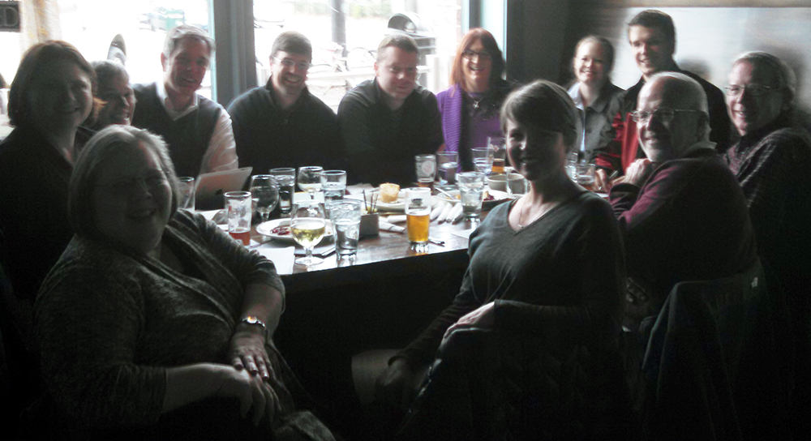
Teaching FLC: Founded in 2010

Slide 3
Principle Participants
Elizabeth White, Libraries
Carol Britton Laws,
Social Work
C. Robert Dove,
Animal and Dairy
Andrew Owsiak, SPIA
Lilia Gomez-Lanier,
Texiles, Merchandising and Interiors
Gaylen Edwards, Vet. School
Jennifer Atkinson, Terry
Catherine White, Pharmacy
Ellie Lanier, Law School
Janine Aronson, Terry
Zhongjin Lu, Terry
Kris McWhite, Terry
Keith Nichols, Libraries

Slide 4
Ritual Knowledge
Students learn the ritual responses to definitional questions and quantitative problems, but their intuitive beliefs and interpretations resurface in quantitative modeling and outside-of-classroom contexts.

Slide 5
Threshold concepts
Disciplines have “threshold concepts”:
Concept/practice that functions as an opening up of a new landscape to the discipline
Distinguished from “core concepts,” TCs are more about “seeing things in a new way.”
Jane H.F. Meyer and Ray Land
https://www.youtube.com/watch?v=WR1cXIdWnNU

Slide 6
Threshold Concepts (cont.)
Represent a transformed way of understanding, or interpreting, or viewing something, without which the learner finds it difficult to progress within the curriculum as formulated.
Consequence of comprehending a threshold concept: maybe a transformed internal view of subject matter, subject landscape, or even world view.

Slide 7
Threshold concepts (vs. core concepts)
Transformative
Integrative
Irreversible
Bounded
Troublesome*

Slide 8
Other examples
Literary studies—signification, deconstruction
Accounting— depreciation
Biology, Psychology—“evolution”
Politics—“the state”
History—“Asiatic conceptions of time”
Plant Science—“Photoprotection”
Health Science—“care”

Slide 9
Example for Our FLC
Keith Nichols, Libraries
Threshold Concept: Information as process, not product
Students have a difficulty understanding how information is created and that authority is based upon origins, discipline-specific contexts, and suitability
Information as commodity vs. free
Information is not static
Change in practice: integrate theoretical in library orientation to deepen understanding of what constitutes library research

Slide 10
Example for Our FLC
Ellie Lanier, Law School
Threshold Concept: Positive Neutrality
In mediation, PN the ability of a mediator to accept and hold both sides of a conflict as equally valid
Challenge for law students: not taking sides
Challenge: moving from judging to mediating
Change in practice: making the implicit explicit in teaching legal mediation.

Slide 11
Ready for 2015-2016
Come join us!
Next year we are starting with a compilation of topics after which each FLC member will vote for 2. We will cover topics that get the most votes.
People will share examples of that topic, discuss challenges and make changes in their teaching.

